Slide 1

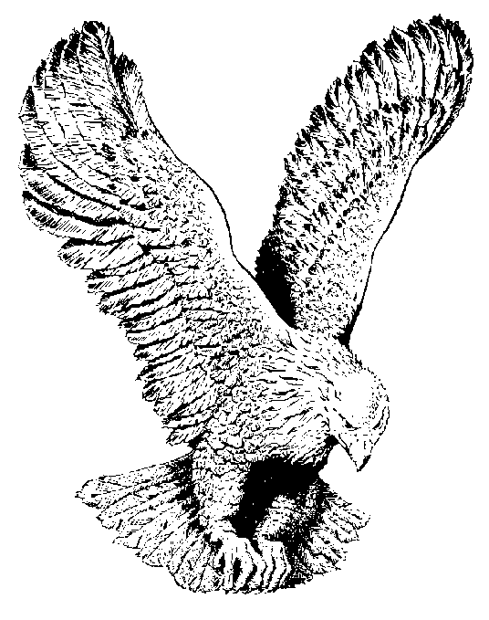
1
ONLY BELIEVE
Fear not, little flock, from the cross to the throne,
From death into life He went for His own;
All power in earth, all power above,
Is given to Him for the flock of His love.

Slide 2
CHORUS
Only believe, only believe,
All things are possible, only believe;
Only believe, only believe,
All things are possible, only believe.
(Lord, I believe…)
(Lord, I receive …)
(Jesus is here …)

Slide 3
Fear not, little flock, He goeth ahead,
Your Shepherd selecteth the path you must tread;
The waters of Marah He’ll sweeten for thee,
He drank all the bitter in Gethsemane.

Slide 4
Fear not, little flock, whatever your lot,
He enters all rooms, “the doors being shut;”
He never forsakes, He never is gone,
So count on His presence in darkness and dawn.

